Slide 1
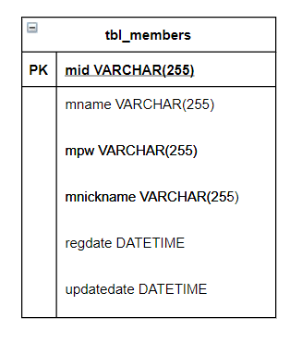
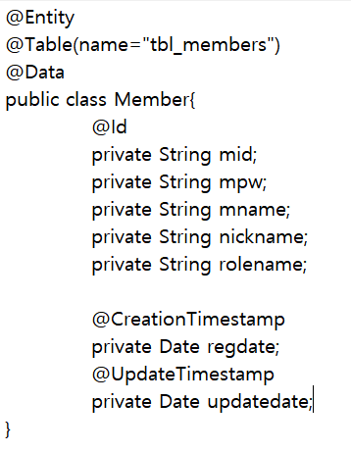

Slide 2
JPA
JPQL
MySQL API
DataBase
Oracle API
Java Code
DB2 API
etc

Slide 3
JPA
Hibernate
EclipseLink
DataNucleus
Etc...

Slide 4
Application
JPA
JDBC
DataBase

Slide 5
Persistence Context
Entity
Entity
Entity Manager
JDBC
Entity
Entity

Slide 6
Detached
detach()
clear()
close()
merge()
find()
JPQL
persist()
DB
New
Managed
flush()
remove()
persist()
flush()
flush()
Removed

Slide 7
Repository<T,ID>
CrudRepository<T,ID>
PagingAndSortingRepository<T,ID>

